Slide 1
PSTAT 130
SAS Base Programming
- Lecture 5 -
Dr. Julie Swenson

Slide 2
Class Exercise
Class Exercise:
Use the data set staff in the data1 folder.
Create a format that assigns:
‘Salary’ to the value S
‘Hourly’ to the value H
Create a format that assigns:
‘Low’ to a value less than 800
‘Moderate’ to a value between 800 and 1200
‘High’ to a value greater than 1200

Slide 3
Class Exercise
Class Exercise (continued)
Create a report that displays Name, DOB, WageCategory, Bonus (in this order)
Suppress observation numbers
Use ‘Full Name’, ‘Birth Date’, ‘Wage Category’, and ‘Bonus Level’ as the column headers
Apply the appropriate formats to WageCategory and Bonus.
Apply a date format to DOB that displays dates in the form 09APR2015.
Now create the same report, but only select individuals whose bonus is greater than 1000.

Slide 4
Objectives
SAS Data Sets
PROC SORT
DATA Step
Read existing SAS data sets
Read raw data (intro)

Slide 5
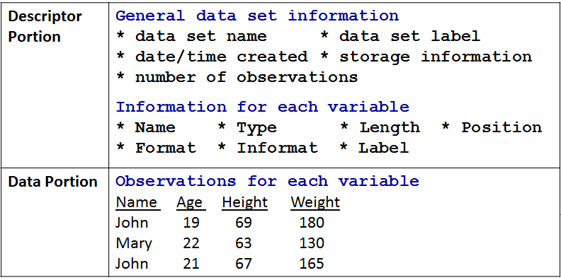
SAS Data Sets
SAS data sets have a descriptor portion and a data portion

Slide 6
Data Portion
The data portion of a SAS data set is a rectangular table of character and/or numeric data values
Job
LastName FirstName Code Salary
GOLDENBERG DESIREE PILOT 50221.62
WILLIAMS ARLENE M. FLTAT 23666.12
PERRY ROBERT A. FLTAT 21957.71
MCGWIER-WATTS CHRISTINA PILOT 96387.39
SCOTT HARVEY F. FLTAT 32278.40
THACKER DAVID S. FLTAT 24161.14
BELL THOMAS B. PILOT 59803.16
GLENN MARTHA S. PILOT 120202.38
Variable Names
Variable Values
Character Values
Numeric Values

Slide 7
Note: Missing Data Values
A value must exist for every variable for each observation. Missing values are valid values.
Job
LastName FirstName Code Salary
GOLDENBERG DESIREE PILOT 50221.62
WILLIAMS ARLENE M. FLTAT 23666.12
PERRY ROBERT A. FLTAT .
MCGWIER-WATTS CHRISTINA PILOT 96387.39
SCOTT HARVEY F. 32278.40
A character missing
value is displayed as a blank.
A numeric
missing value
is displayed as
a period.

Slide 8
Descriptor Portion
The descriptor portion of a SAS data set contains
General information about the SAS data set (such as data set name and number of observations)
Variable attributes (name, type, length, position, informat, format, label)
The CONTENTS procedure (PROC CONTENTS) displays the descriptor portion of a SAS data set

Slide 9
CONTENTS Procedure
General form of the PROC CONTENTS step:
Example
PROC CONTENTS DATA=<SAS-data-set>;
RUN;
proc contents data=data1.empdata;
run;

Slide 10
Descriptor Portion
Metainfo about the mdata
The SAS System
The CONTENTS Procedure
Data Set Name DATA1.EMPDATA Observations 8
Member Type DATA Variables 5
Engine V9 Indexes 0
Created Sunday, October 03, Observation Length 48
2010 04:12:45 PM
Last Modified Sunday, October 03, Deleted Observations 0
2010 04:12:45 PM
Protection Compressed NO
Data Set Type Sorted NO
Label
Data Representation WINDOWS_32
Encoding wlatin1 Western (Windows)
Alphabetic List of Variables and Attributes
# Variable Type Len
1 EmpID Char 4
3 FirstName Char 13
4 JobCode Char 5
2 LastName Char 13
5 Salary Num 8

Slide 11
CONTENTS Procedure
Contents of entire library
Using the _ALL_ keyword to list all the SAS files in the library and the NODS option to suppress the descriptor portions of the data sets.
General form of the NODS option
NODS must be used in conjunction with the keyword _ALL_
The NODS shows
Only the summery not
The description of each
Data set
PROC CONTENTS DATA=libref._ALL_ NODS;
RUN;
proc contents data=data1._all_ nods;
run;

Slide 12
Example Output
The SAS System
The CONTENTS Procedure
Directory
Libref DATA1
Engine V9
Physical Name X:\PStat 130\data1
File Name X:\PStat 130\data1
Member File
# Name Type Size Last Modified
1 ADMIT DATA 9216 12Apr04:10:16:08
2 ADMITJUNE DATA 9216 12Apr04:10:16:08
3 ALLGOALS DATA 5120 12Apr04:10:16:08
4 ALLGOALS2 DATA 5120 12Apr04:10:16:08
5 ALLSALES DATA 5120 12Apr04:10:16:08
6 ALLSALES2 DATA 5120 12Apr04:10:16:08
7 APRTARGET DATA 17408 12Apr04:10:16:08
8 CHICAGO DATA 17408 12Apr04:10:16:14

Slide 13
Example
Class Exercise
Use the staff data set in the data1 folder.
Output the data portion of the data set.
Output the descriptor portion of the data set.

Slide 14
SORT Procedure
Sequencing and grouping observations
Sequence (sort) observations in a SAS data set
Group observations in a list report
Print column subtotals in a list report
Control page breaks for subgroups

Slide 15
Sorting a SAS Data Set
To request subgroup totals in PROC PRINT, the observations in the data set must be grouped
The SORT procedure
Rearranges the observations in a SAS data set
Can create a new SAS data set containing the rearranged observations
Can sort on multiple variables
Can sort in ASCENDING (default) or DESCENDING order
Does not generate printed output
Treats missing values as the smallest possible value

Slide 16
Sorting a SAS Data Set
General form of the PROC SORT step
Examples (sorts the data by Salary)
PROC SORT DATA=input-SAS-data-set
<OUT=output-SAS-data-set>;
BY <DESCENDING> by-variable(s);
RUN;
CAUTION!
Overwrites the original data set with the sorted data set
proc sort data=data1.empdata;
by Salary;
run;
proc sort data=data1.empdata out=work.jobsal;
by Salary;
run;
Saves the sorted data set in new data

Slide 17
Sorting a SAS Data Set
When you include more than one SORT variable in the BY statement
SAS sorts the data set by the first variable listed
Then sorts by the second variable WITHIN the values of the first variable
Then sorts by the third variable WITHIN the values of the second variable, etc.
By default, SAS sorts in ascending order. The keyword DESCENDING applies to the following variable.

Slide 18
Sorting Example
Class Exercise
Use the admit data set in the data1 folder, which contains hospital admitting information on patients
Create a list report
Sort the admit data set into a NEW data set called work.temp_admit
Sort it by Actlevel Sex
Print the new data set
Now sort by Sex Actlevel
Print the new data set

Slide 19
Creating Subgroups
The BY statement (in PROC PRINT) allows you to
Create a separation between listings of several subgroups
Identify each subgroup by the top of its listing
Data set must be sorted on the BY variable first
General form of the BY statement
Example
BY variable(s);
proc print data=data1.admit;
BY Sex;
run;

Slide 20
The SAS System 9:21 Thursday, September 17, 2015 5
--------------------------------------------- Sex=F ----------------------------------------------
Act
Obs ID Name Age Date Height Weight Level Fee
1 2462 Almers, C 34 3 66 152 HIGH 124.80
2 2571 Nunnelly, A 44 19 66 140 HIGH 149.75
3 2575 Quigley, M 40 8 69 163 HIGH 124.80
4 2589 Wilcox, E 41 16 67 141 HIGH 149.75
5 2501 Bonaventure, T 31 17 61 123 LOW 149.75
6 2568 Eberhardt, S 49 27 64 172 LOW 124.80
7 2572 Oberon, M 28 17 62 118 LOW 85.20
8 2588 Ivan, H 22 20 63 139 LOW 85.20
9 2523 Johnson, R 43 31 63 137 MOD 149.75
10 2552 Reberson, P 32 9 67 151 MOD 149.75
11 2584 Takahashi, Y 43 29 65 123 MOD 124.80
--------------------------------------------- Sex=M ----------------------------------------------
Act
Obs ID Name Age Date Height Weight Level Fee
12 2458 Murray, W 27 1 72 168 HIGH 85.20
13 2544 Jones, M 29 6 76 193 HIGH 124.80
14 2586 Derber, B 25 23 75 188 HIGH 85.20
15 2539 LaMance, K 51 4 71 158 LOW 124.80
16 2563 Pitts, D 34 22 73 154 LOW 124.80
17 2579 Underwood, K 60 22 71 191 LOW 149.75
18 2555 King, E 35 13 70 173 MOD 149.75
19 2574 Peterson, V 30 6 69 147 MOD 149.75
20 2578 Cameron, L 47 5 72 173 MOD 124.80
21 2595 Warren, C 54 7 71 183 MOD 149.75

Slide 21
Printing Sorted Observations
If you attempt to use the BY statement on an unsorted data set, you will get an error:
ERROR: Data set DATA1.ADMIT is not sorted in ascending sequence. The current by-group has ActLevel = MOD and the next by-group has ActLevel = LOW.
NOTE: The SAS System stopped processing this step because of errors.
NOTE: There were 2 observations read from the data set DATA1.EMPDATA.

Slide 22
Printing Sub & Grand Totals
Print the data set grouped by ActLevel with a subtotal for the Fee column for each ActLevel
Using a BY statement and a SUM statement together in a PROC PRINT step produces subtotals and grand totals
proc sort data=data1.admit
out=work.admit;
by ActLevel;
run;
proc print data=work.admit;
by ActLevel;
sum Fee;
run;

Slide 23
------------------------------------------ ActLevel=LOW ------------------------------------------
Obs ID Name Sex Age Date Height Weight Fee
8 2501 Bonaventure, T F 31 17 61 123 149.75
9 2568 Eberhardt, S F 49 27 64 172 124.80
10 2572 Oberon, M F 28 17 62 118 85.20
11 2588 Ivan, H F 22 20 63 139 85.20
12 2539 LaMance, K M 51 4 71 158 124.80
13 2563 Pitts, D M 34 22 73 154 124.80
14 2579 Underwood, K M 60 22 71 191 149.75
-------- ------
ActLevel 844.30
------------------------------------------ ActLevel=MOD ------------------------------------------
Obs ID Name Sex Age Date Height Weight Fee
15 2523 Johnson, R F 43 31 63 137 149.75
16 2552 Reberson, P F 32 9 67 151 149.75
17 2584 Takahashi, Y F 43 29 65 123 124.80
18 2555 King, E M 35 13 70 173 149.75
19 2574 Peterson, V M 30 6 69 147 149.75
20 2578 Cameron, L M 47 5 72 173 124.80
21 2595 Warren, C M 54 7 71 183 149.75
-------- ------
ActLevel 998.35
======
2687.0

Slide 24
Page Breaks
Use the PAGEBY statement to put each subgroup on a separate page
General form of the PAGEBY statement
Example
The PAGEBY statement must be used with a BY statement
PAGEBY by-variable;
proc print data=work.admit;
by ActLevel;
pageby ActLevel;
sum Fee;
run;

Slide 25
Another Sorting Example
Class Exercise
Use the admit data set located in the data1 folder
Create the following report:
Set firstobs=5 and obs=15
Has the title: ‘Admittance Report’
Is sorted by Sex and Name
Groups the patients with a different Sex on each page
Produces subtotals and a grand total for the Fee
Suppresses the Obs column
Displays subtotal and total number of observations

Slide 26
Another Sorting Example (con’t)
How many observations are on each page?
Is this what you expected?
How would we change the program such that the output displays observations 5-15 from the sorted data set?

Slide 27
Identifying Observations
The ID statement allows you to
Suppress the Obs column in the report
Specify which variable(s) should replace the Obs column
General form of the ID statement
Example
ID variable(s);
proc print data=data1.empdata;
id JobCode;
var EmpID Salary;
run;

Slide 28
Special By-Group Formatting
When the ID and BY statements specify the same variable
the Obs column is suppressed
the BY line is suppressed
the ID/BY variable prints in the leftmost column
each ID/BY value only prints at the start of each BY group (and on the subtotal line, if a SUM statement is used)

Slide 29
Special By-Group Formatting
Specify JobCode in the BY and ID statements to change the report format.
proc sort data=data1.empdata out=work.empdata;
by JobCode;
run;
proc print data=work.empdata;
by JobCode;
id JobCode;
sum Salary;
run;

Slide 30
Special By-Group Formatting
The SAS System
Job Emp
Code ID LastName FirstName Salary
FLTAT 0040 WILLIAMS ARLENE M. 23666.12
0071 PERRY ROBERT A. 21957.71
0091 SCOTT HARVEY F. 32278.40
0106 THACKER DAVID S. 24161.14
----- ---------
FLTAT 102063.37
PILOT 0031 GOLDENBERG DESIREE 50221.62
0082 MCGWIER-WATTS CHRISTINA 96387.39
0355 BELL THOMAS B. 59803.16
0366 GLENN MARTHA S. 120202.38
----- ---------
PILOT 326614.55
=========
428677.92

Slide 31
DATA Step
Now, let’s go back to the data step
What is the most important thing we want to do in this step?

Slide 32
SAS Data Sets
Data Entry
External File
Other Software Files
Conversion Process
SAS Data Set
Descriptor Portion
Data Portion

Slide 33
SAS Data Sets

Slide 34
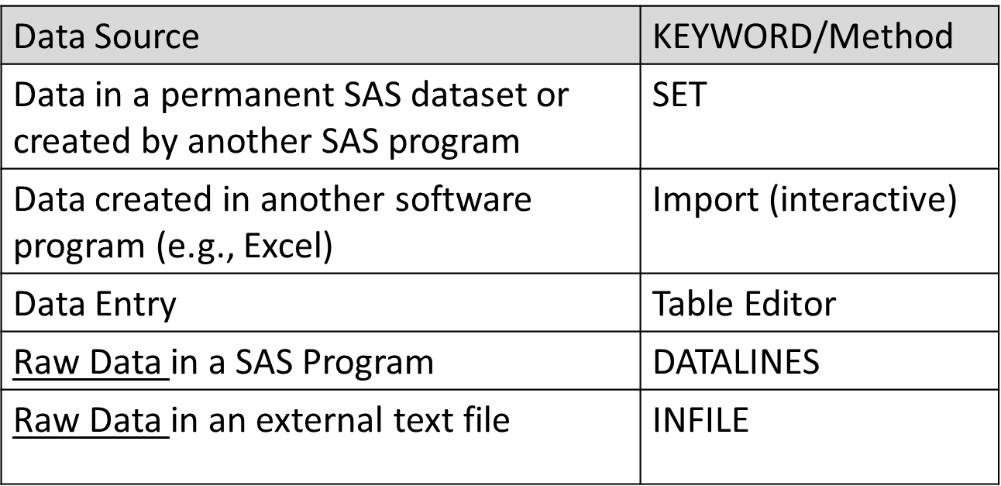
Creating a SAS Data Set

Slide 35
Using an Existing SAS Data Set
To create a SAS data set from an existing SAS data set, you need to
Use a DATA statement to name the output SAS data set
Use the SET statement (in the DATA step) to read the existing SAS data set
Example
SET can refer to an existing SAS data set, temporary, or permanent
data work.temp_empdata;
set data1.empdata;
run;

Slide 36
Naming a SAS Data Set
General form of the DATA statement
This DATA statement creates a temporary SAS data set
This DATA statement creates a permanent SAS data set
data work.dfwlax;
set ia.dfwlax;
run;
libname mydrive 'D:\';
data mydrive.dfwlax;
set ia.dfwlax;
run;

Slide 37
Importing Data From Other Software
If your data were created by other software (i.e. Excel)
Use the IMPORT option on the File menu to read it in and create a new SAS data set
You will need to tell SAS
What format the data are in
Where the file is stored
What character is used to separate data values (i.e. the “delimiter”)
Save your SAS data set in an existing library or create a new library.

Slide 38
SAS Table Editor
Create a SAS data set using the Table Editor
Go to Menu → Tools → Table Editor
Enter data values into the table
Set the name, type, and width for each variable/column using Data Menu – Column Attributes (or right-click on each column heading)
Save the data set into a library (you can create a library at this time, if desired)
You can now use this SAS data set in your program

Slide 39
Using Raw Data
To create a SAS data set from raw data, you need to
Use a DATA statement to name the output SAS data set
Use an INFILE or DATALINES statement to identify where to find the raw data
Use an INPUT statement to identify the variables in the raw data file

Slide 40
Raw Data Within a SAS Program
If the raw data is contained in the SAS program
Use the DATALINES keyword, followed by the raw data lines
Example:
Remember that this method works well for small amounts of data
data work.sample;
input firstname $ gender $ age;
datalines;
John Male 22
Jane Female 19
;
run;

Slide 41
Pointing to a Raw Data File
If the raw data are contained in a separate text file
Use the INFILE statement, followed by a file specification.
Example
This method is much more common than DATALINES
The file specification does not use a library reference
The INFILE statement comes before the input statement.
data work.sample;
infile 'D:\UCSB\sample.txt';
input name $ gender $ age;
run;

Slide 42
Datalines vs. Infile
The DATALINES method
Allows you to see your data directly
Is good for small amounts of data
Is often used to create “test” data sets
The INFILE method
Is more common
Is necessary if your data comes from an outside source (i.e. client, download, website, etc.)
Is preferred for large data sets
Allows you to easily re-run your programs on updated data

Slide 43
Reading Data Fields
The INPUT statement tells SAS the name and type of each variable in the data set, and how to read the data
Simple form of the INPUT statement
General form of the INPUT statement
INPUT variable <$> <options>;
INPUT variable <$> start-column <-- end-column> <.decimals> <@|@@>;
INPUT <pointer-control> variable <$> <:|&|~> <informat.> <@|@@>;

Slide 44
Input Statement Example
data work.students;
input firstname $ gender $ age;
datalines;
John Male 19
Wendy Female 22
;
run;

Slide 45
Types of Raw Data Input
List Input – each data value is separated by a space (the “delimiter”)
John Male 22
Wendy Female 19
Column input – each data value is in a fixed location
John Male 22
Wendy Female 19
Formatted input – uses SAS formats (called informats)
John Male 4/12/91
Elizabeth Female 8/24/90

Slide 46
Format vs. Informat
A Format controls the way data look SAS outputs (displays) data.
An Informat controls the way SAS reads in data.

Slide 47
Questions?

